Slide 1

Notes:
Recommended for:
SG, MY, PH, ID, TH, TW

Slide 2
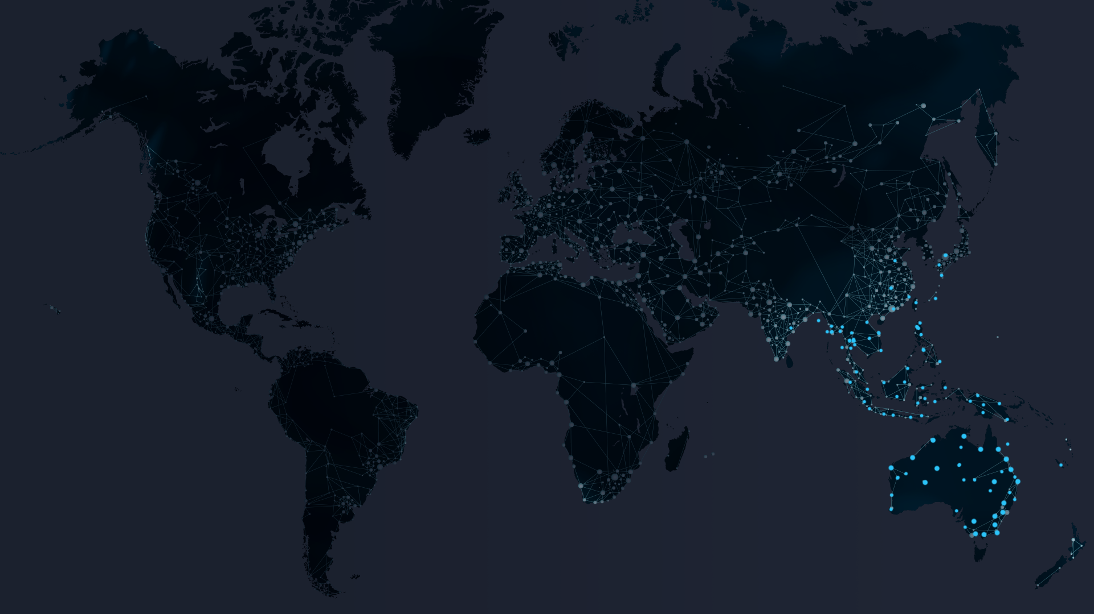
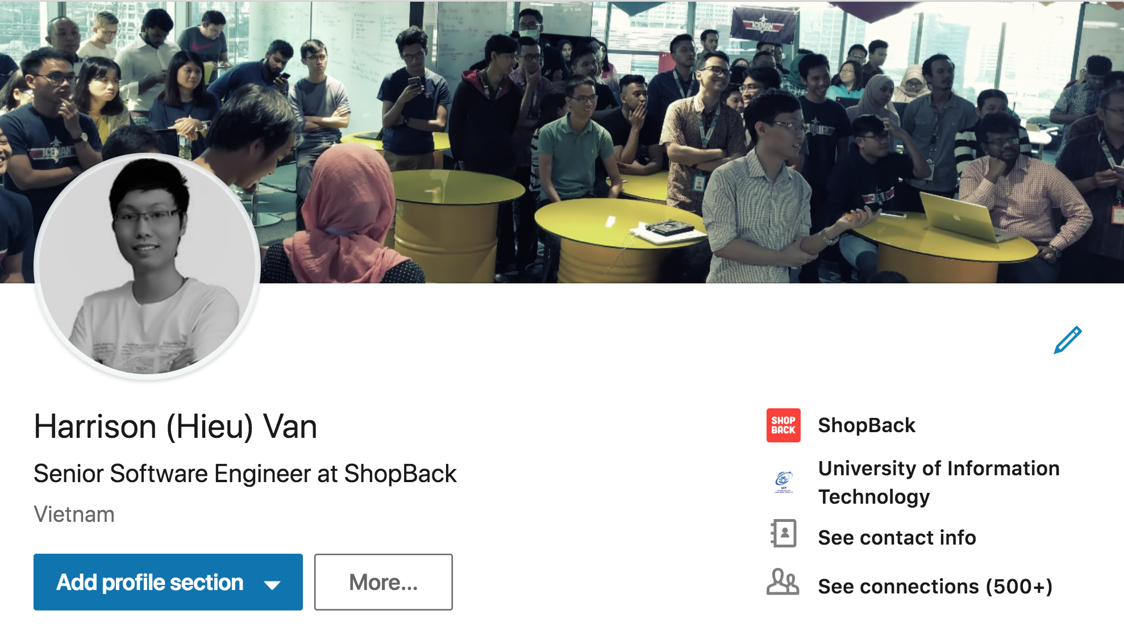

About Me
Notes:
Demonstrates ShopBack’s business scale; Applicable for all countries

Slide 3
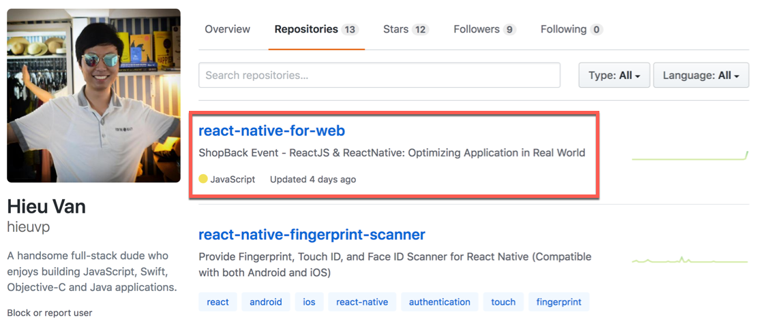
Materials
https://github.com/hieuvp/react-native-for-web

Slide 4

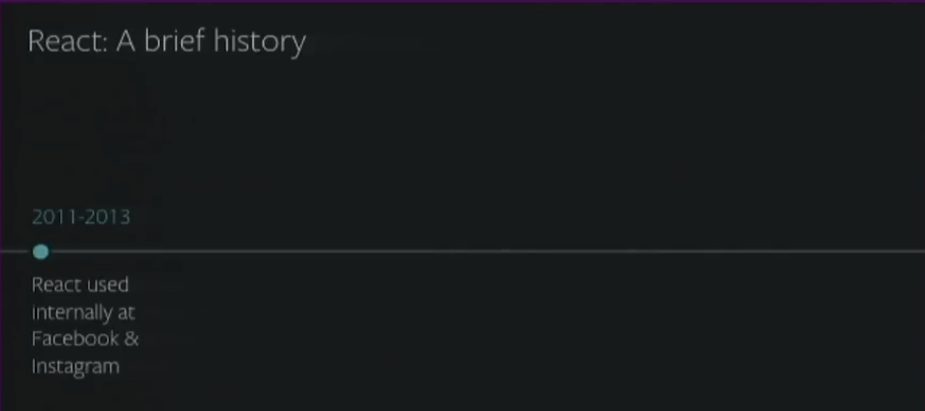
Cross-Platform React
Notes:
Demonstrates ShopBack’s business model; For SG, MY, PH, ID, TH, TW

Slide 5
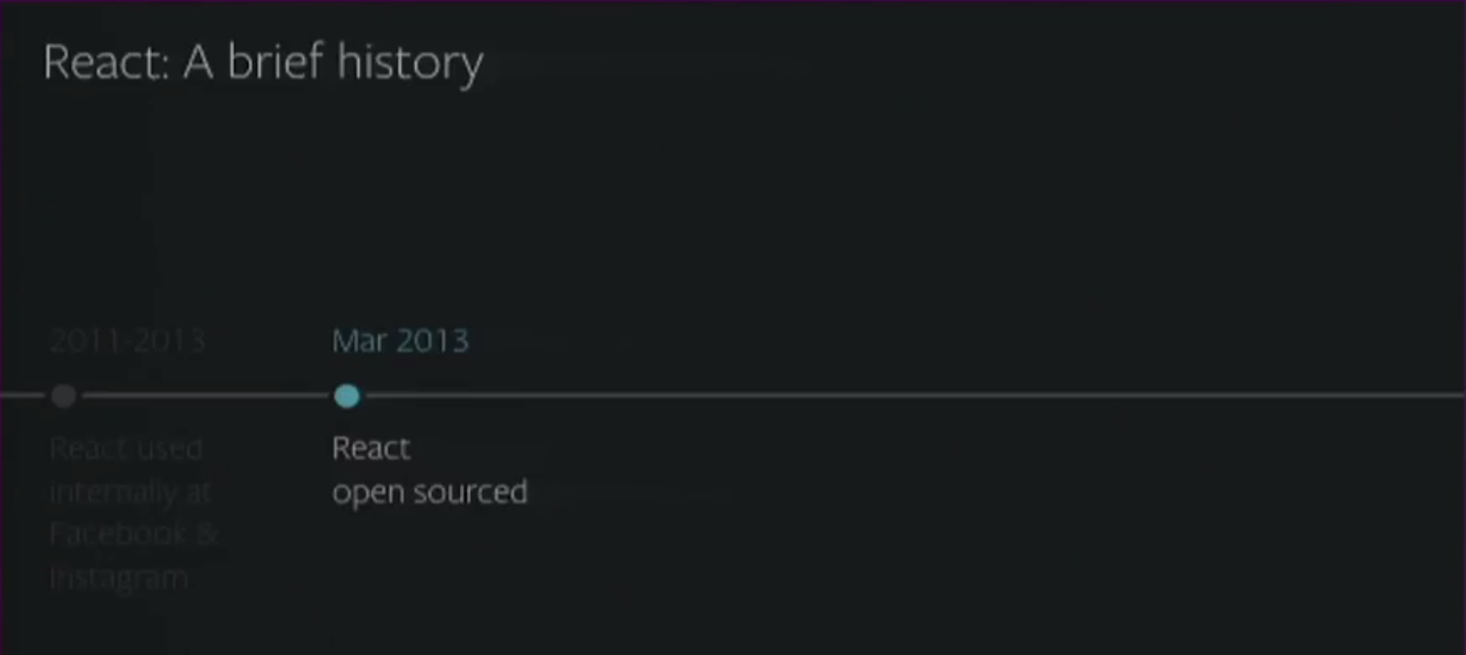
Cross-Platform React
Notes:
Demonstrates ShopBack’s business model; For SG, MY, PH, ID, TH, TW

Slide 6


What is React Native ?
Notes:
Detailed ShopBack’s business model: Customer + Merchant journey
For all countries

Slide 7
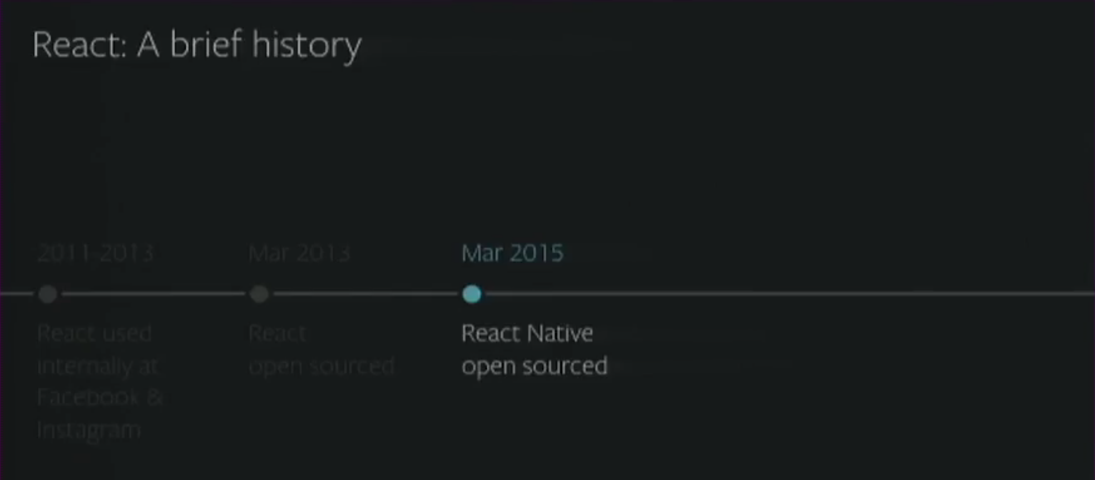
Cross-Platform React
Notes:
Demonstrates ShopBack’s business model; For SG, MY, PH, ID, TH, TW

Slide 8
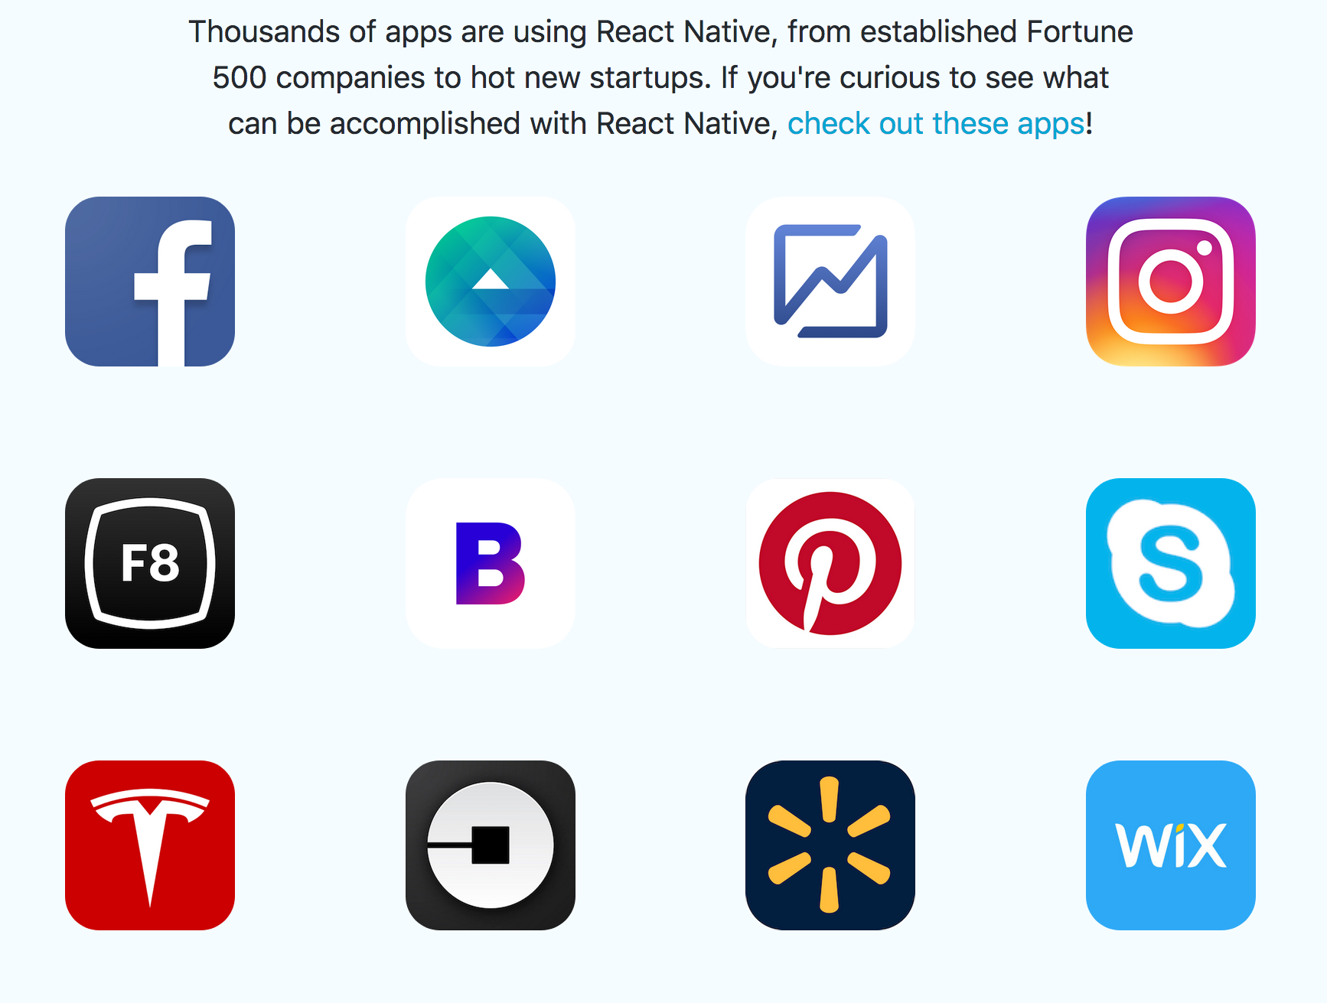
Who is using React Native ?
https://facebook.github.io/react-native/
Notes:
Detailed ShopBack’s business model: Customer + Merchant journey
For all countries

Slide 9
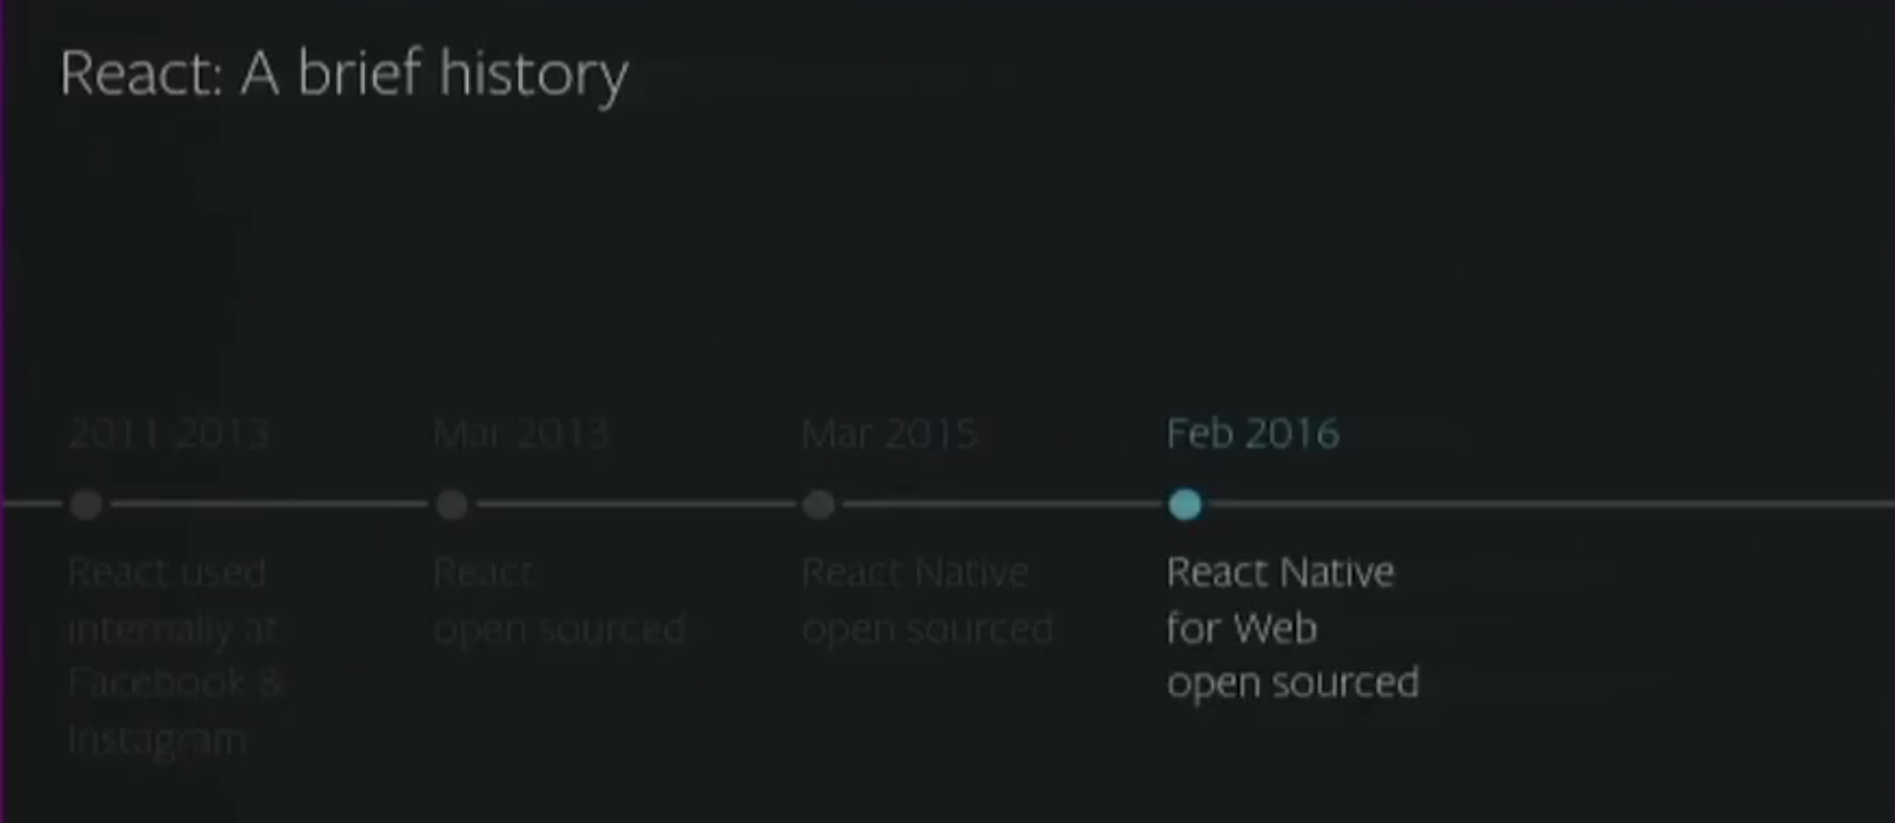
Cross-Platform React
Notes:
Demonstrates ShopBack’s business model; For SG, MY, PH, ID, TH, TW

Slide 10
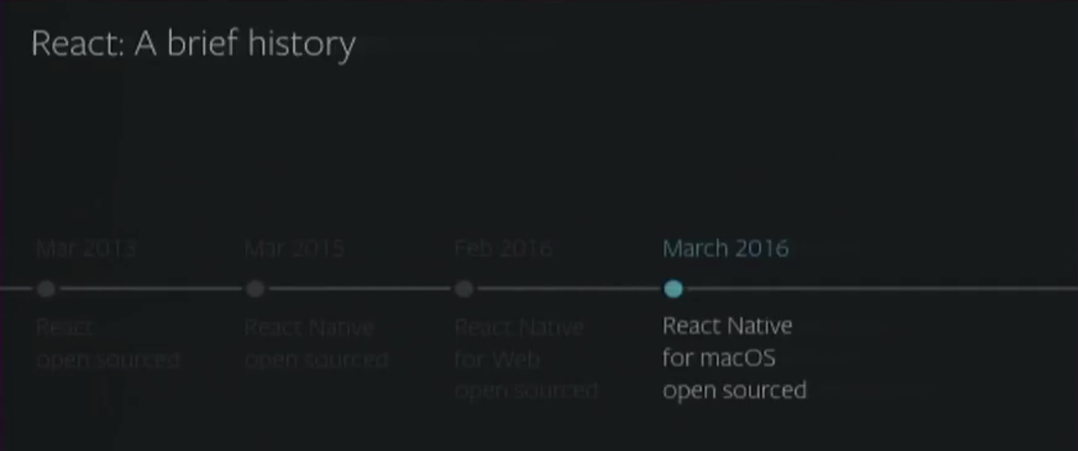
Cross-Platform React
Notes:
Demonstrates ShopBack’s business model; For SG, MY, PH, ID, TH, TW

Slide 11
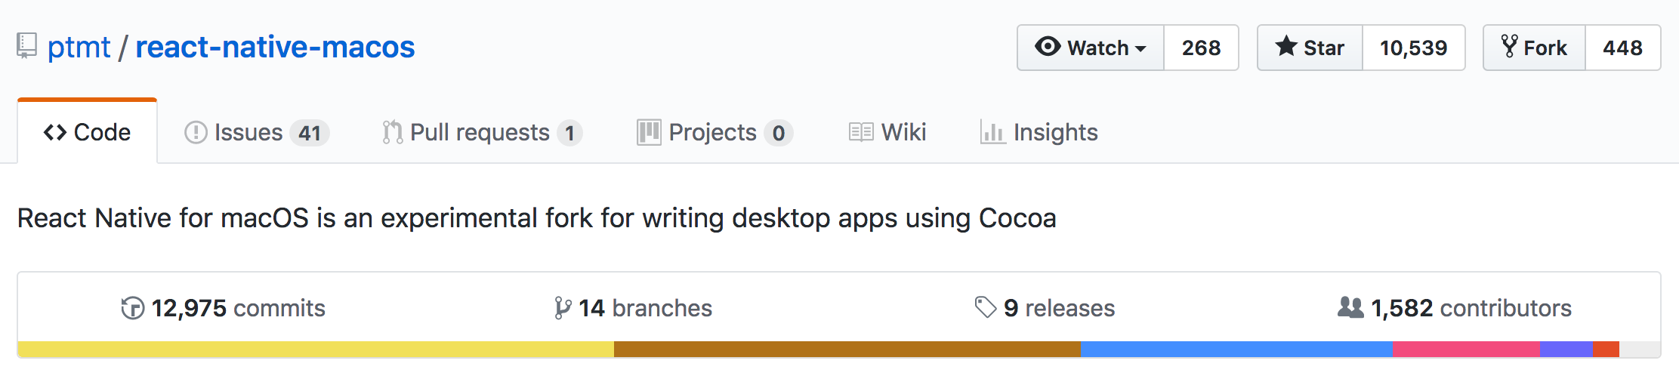
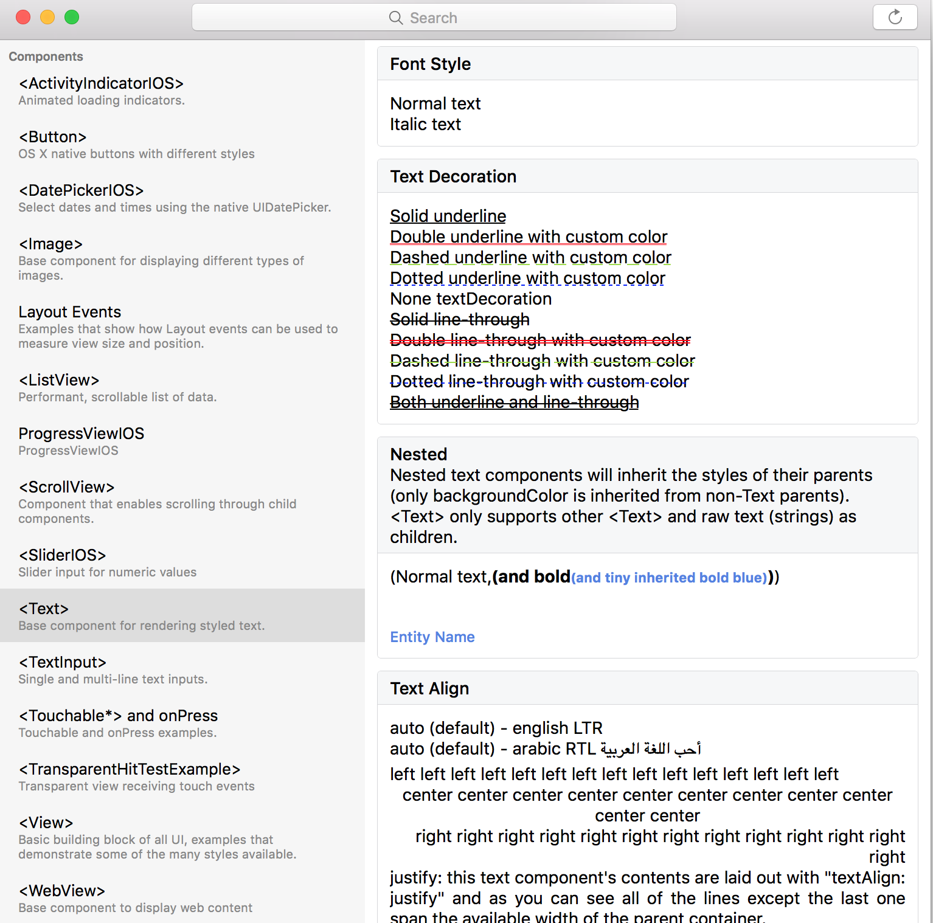
https://github.com/ptmt/react-native-macos

Slide 12
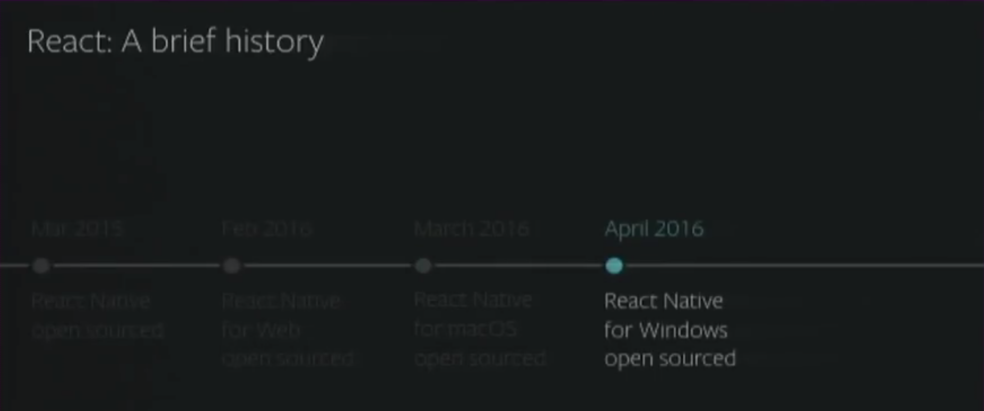
Cross-Platform React
Notes:
Demonstrates ShopBack’s business model; For SG, MY, PH, ID, TH, TW

Slide 13
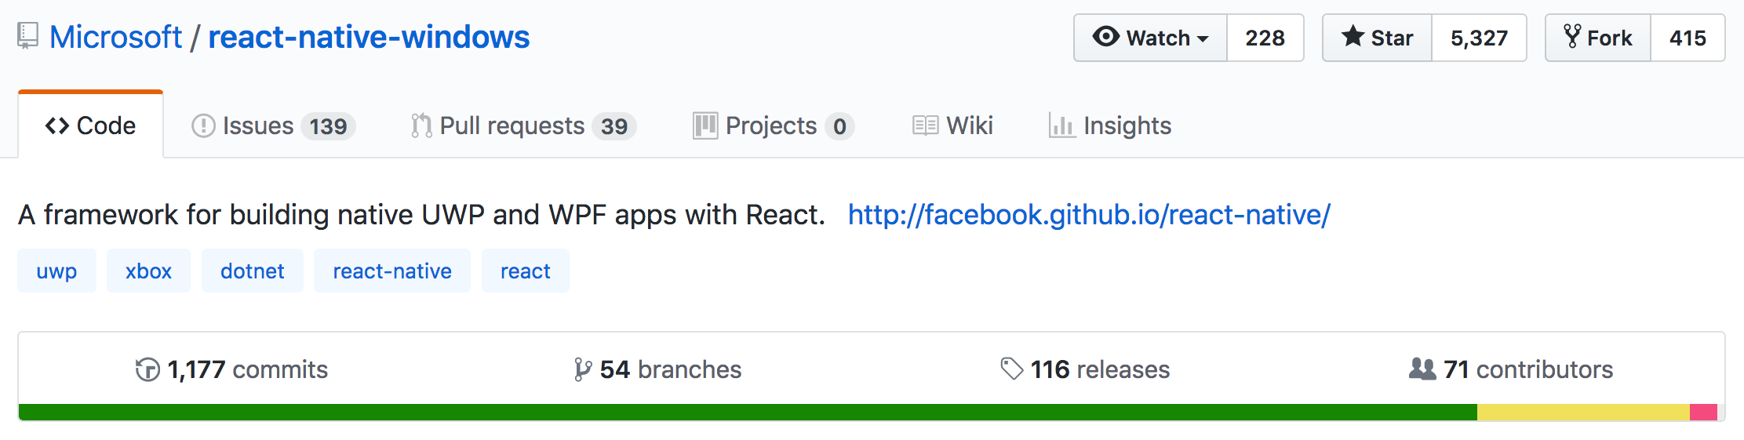
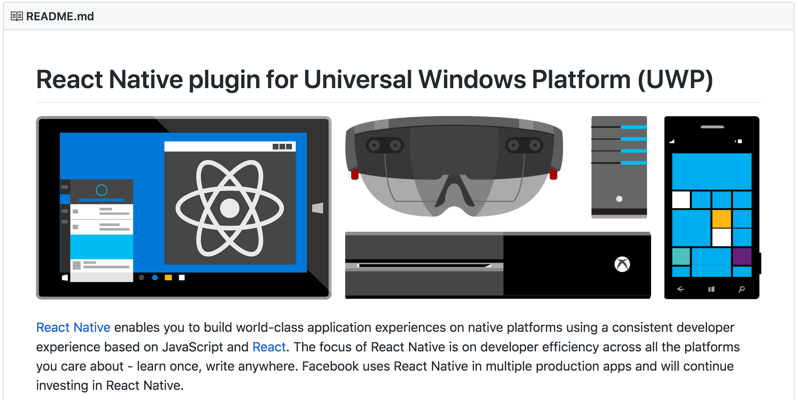
https://github.com/Microsoft/react-native-windows

Slide 14
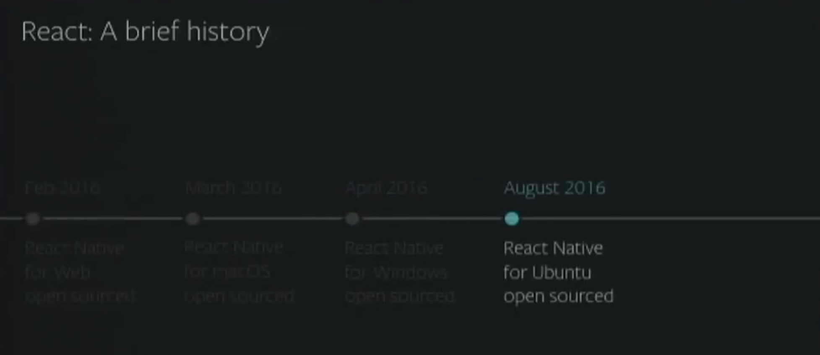
Cross-Platform React
Notes:
Demonstrates ShopBack’s business model; For SG, MY, PH, ID, TH, TW

Slide 15
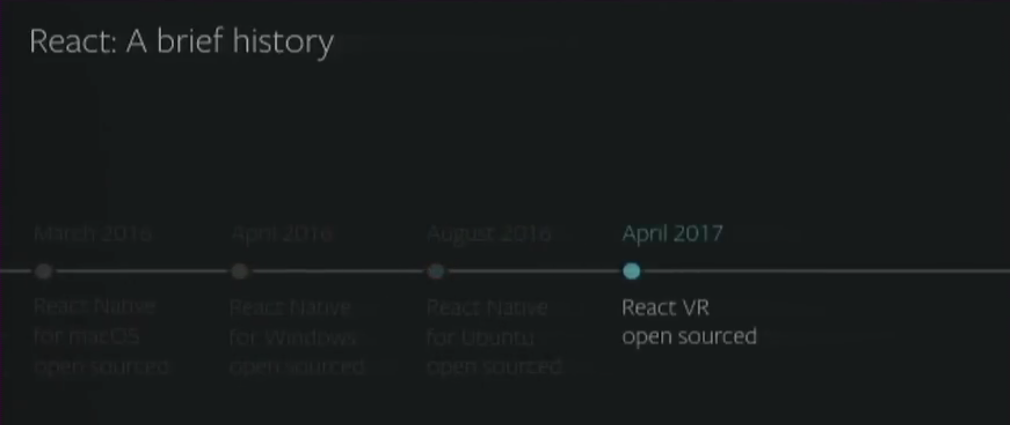
Cross-Platform React
Notes:
Demonstrates ShopBack’s business model; For SG, MY, PH, ID, TH, TW

Slide 16
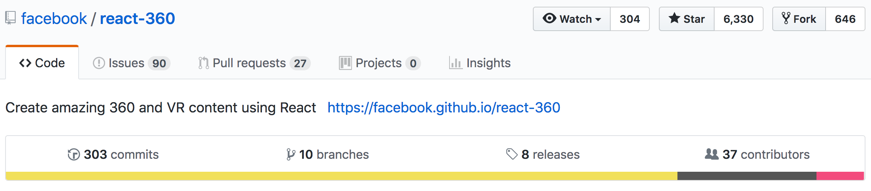
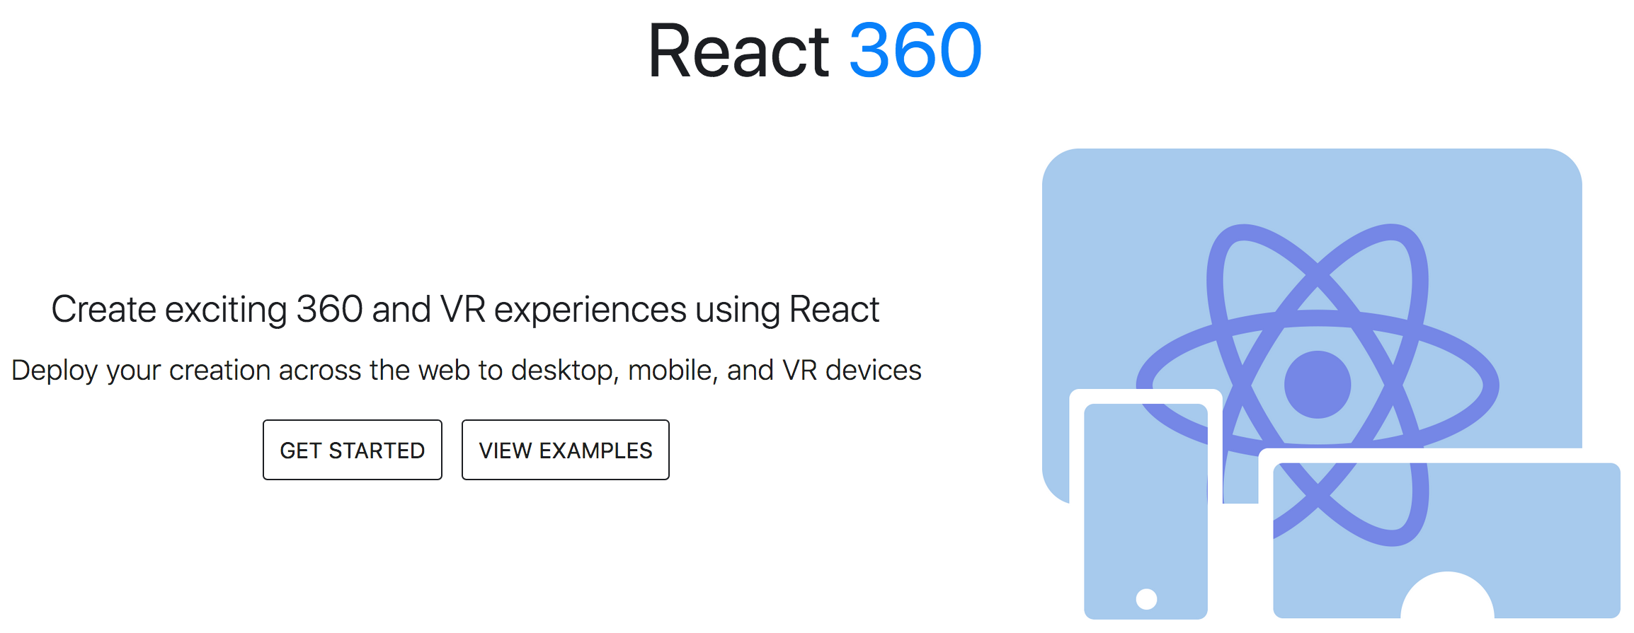
https://facebook.github.io/react-360/

Slide 17

React
Learn Once, Write Anywhere.
Notes:
ShopBack Mission Statement
Special for AU

Slide 18

Questions and Answers

Slide 19
What is React Native for Web ?
Notes:
Detailed ShopBack’s business model: Customer + Merchant journey
For all countries

Slide 20

React Native for Web
https://github.com/necolas/react-native-web
Notes:
Detailed ShopBack’s business model: Merchant journey
For all countries

Slide 21
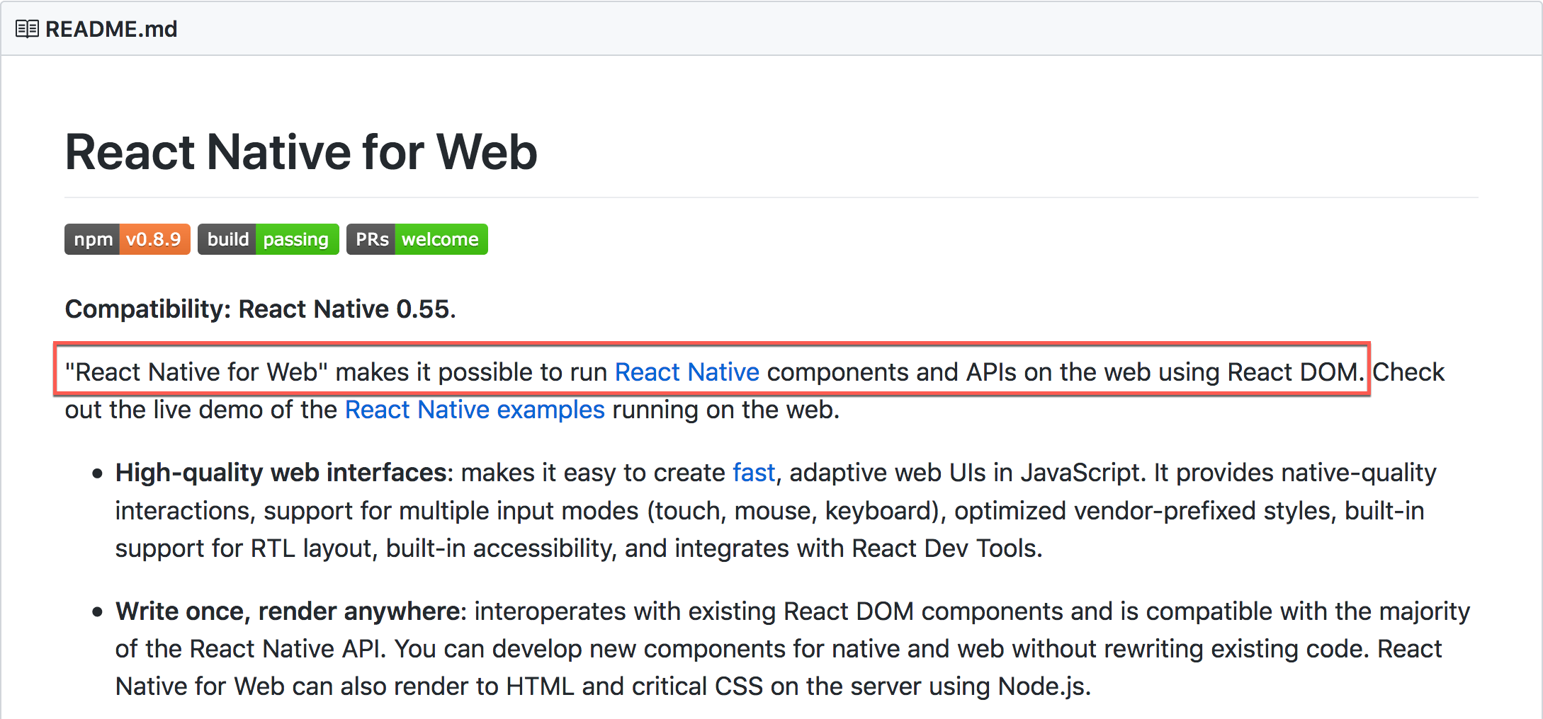
Why React Native for Web ?
Notes:
Detailed ShopBack’s business model: Customer + Merchant journey
For all countries

Slide 22
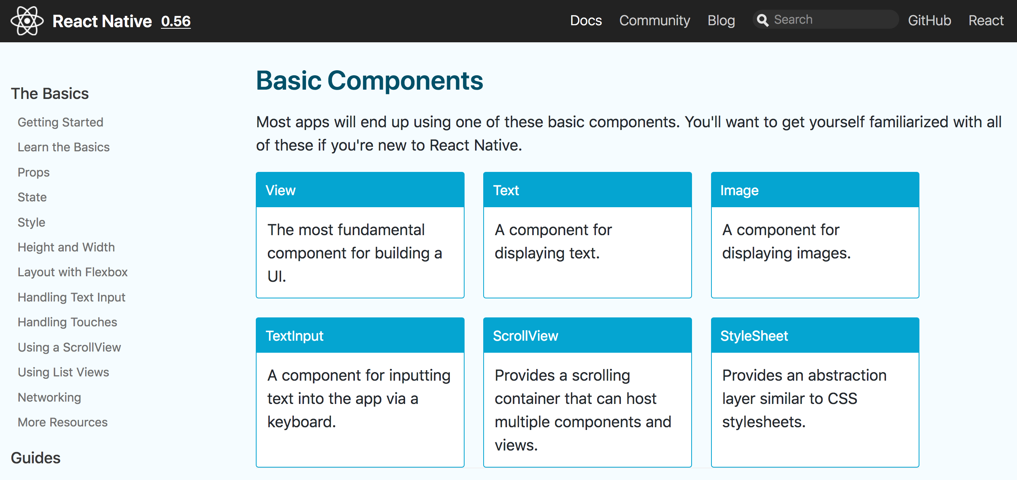
https://facebook.github.io/react-native/docs/components-and-apis.html

Slide 23
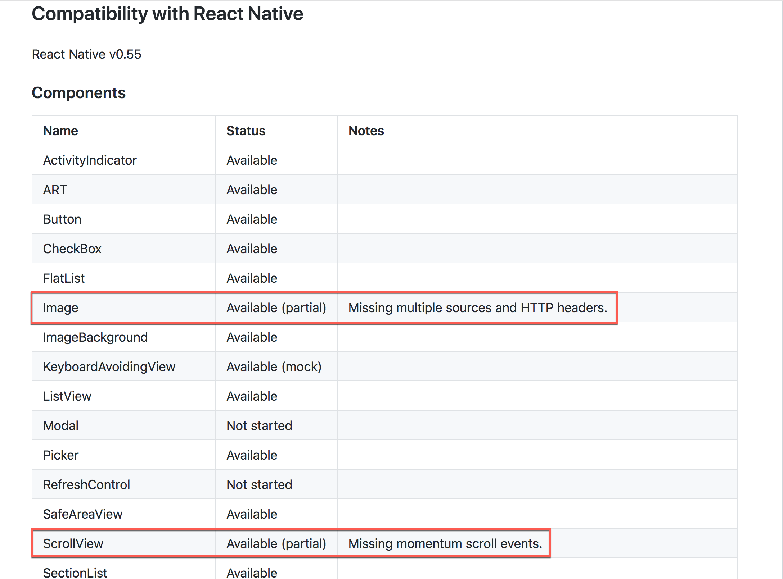
https://github.com/necolas/react-native-web#compatibility-with-react-native

Slide 24
Who is using React Native for Web in production ?
Notes:
Detailed ShopBack’s business model: Customer + Merchant journey
For all countries

Slide 25
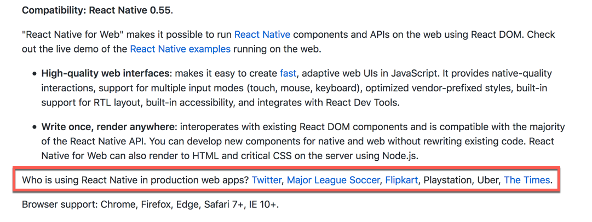
Who is using React Native for Web in production ?
Notes:
Detailed ShopBack’s business model: Customer + Merchant journey
For all countries

Slide 26
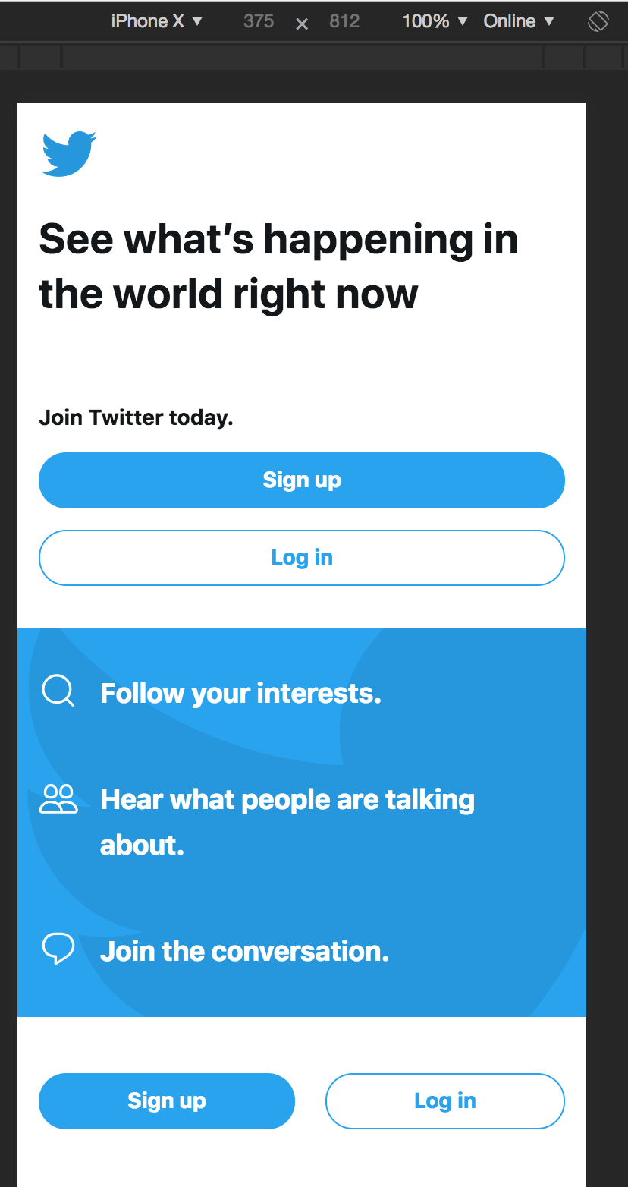
https://mobile.twitter.com/

Slide 27
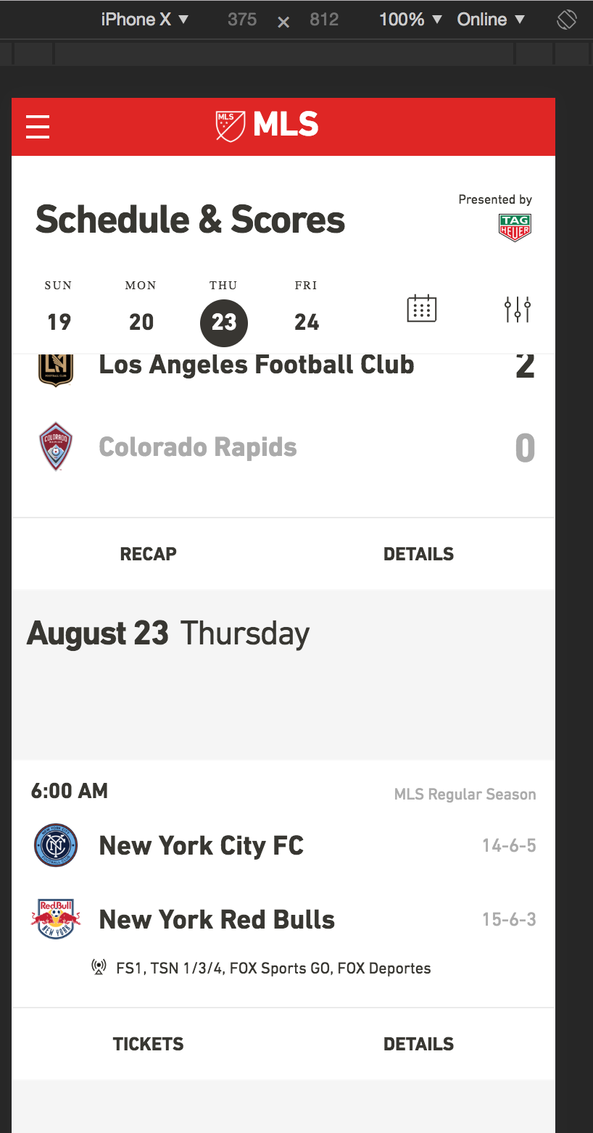
https://matchcenter.mlssoccer.com/schedule

Slide 28
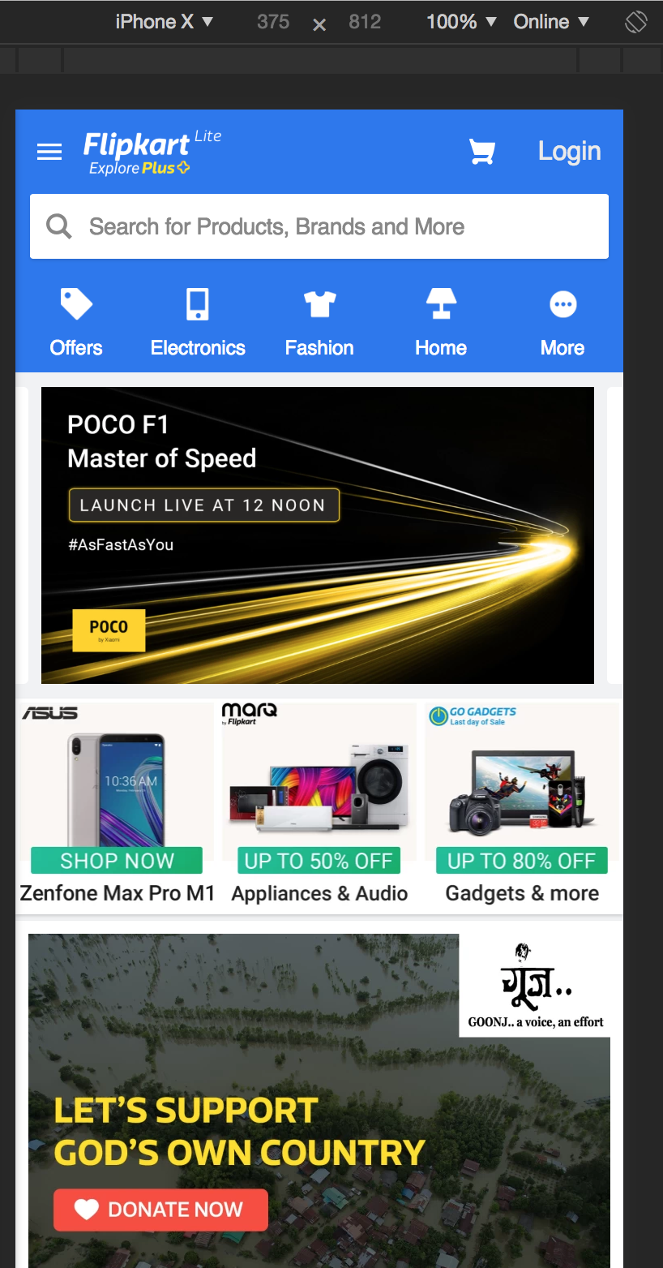
https://www.flipkart.com/

Slide 29
Questions and Answers

Slide 30

Installation
Notes:
Recommended for: AU

Slide 31
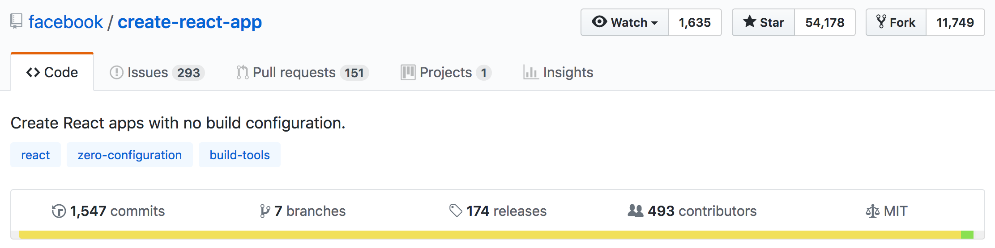
Create React App
https://github.com/facebook/create-react-app
Notes:
All slides to adopt the above format - Font Type, Font Size, Footer

Slide 32
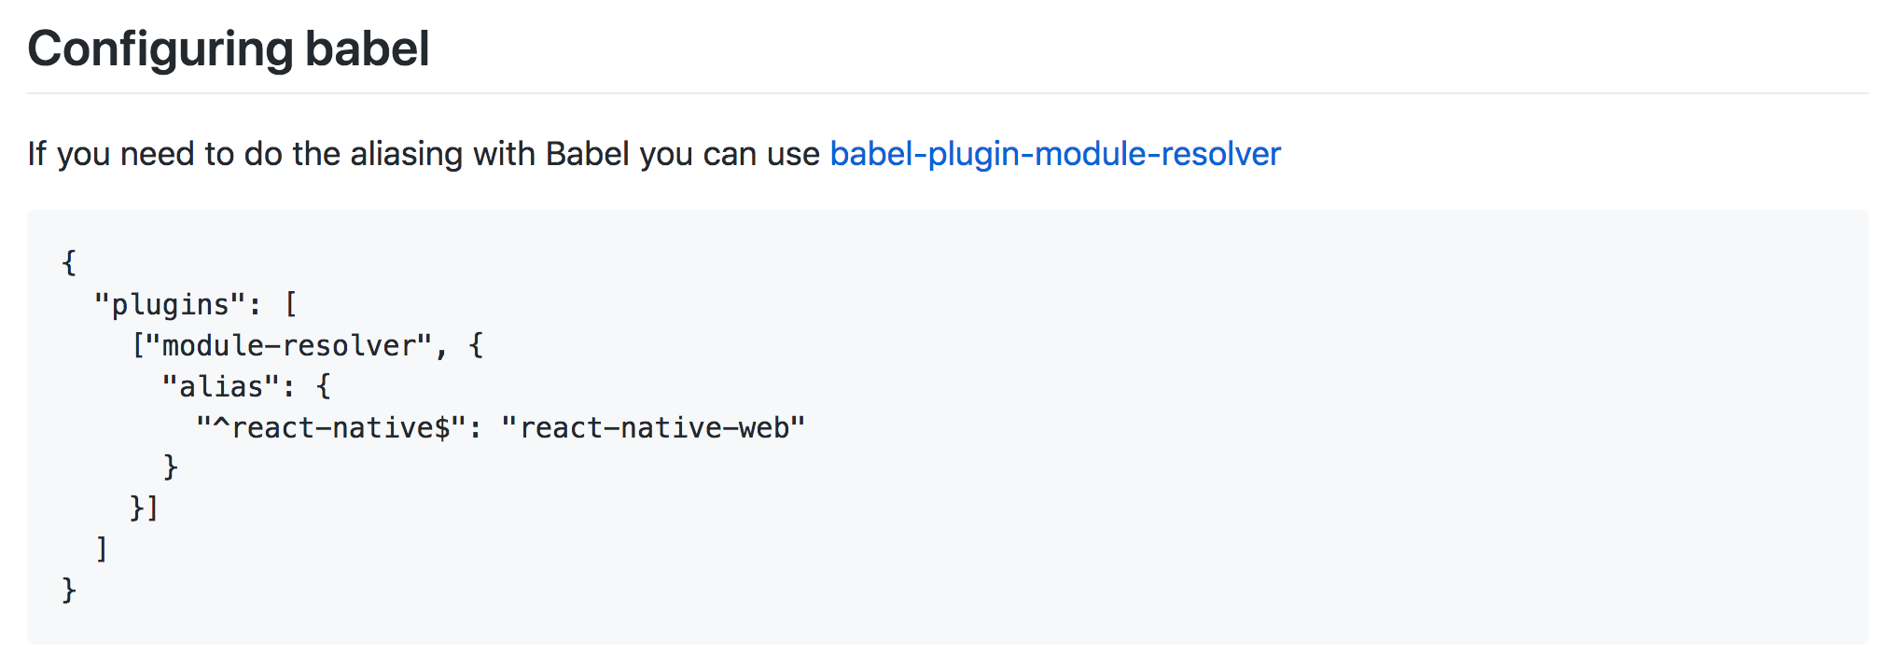
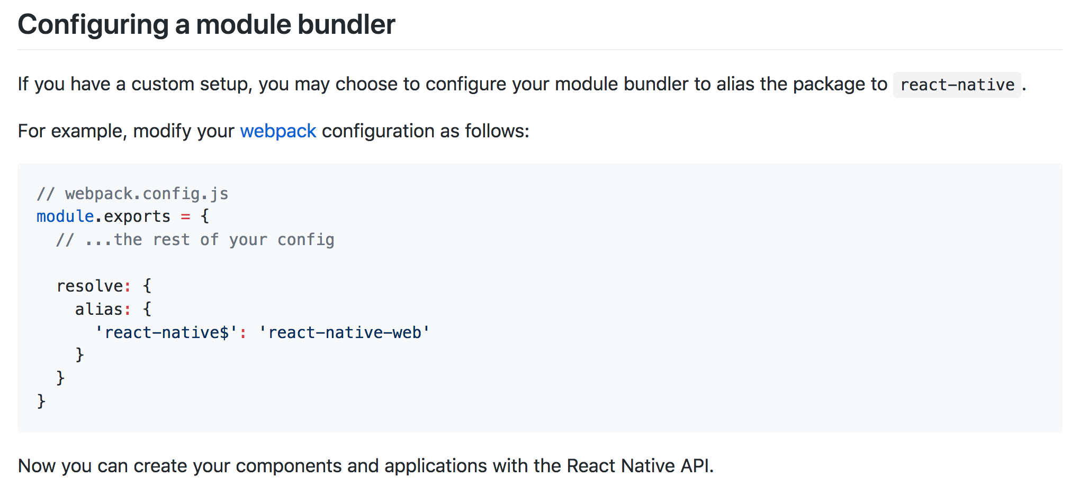

Slide 33
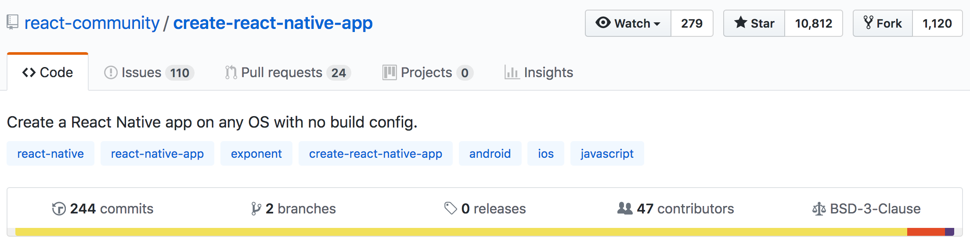

Create React Native App
https://github.com/react-community/create-react-native-app
https://expo.io/features
Notes:
All slides to adopt the above format - Font Type, Font Size, Footer

Slide 34
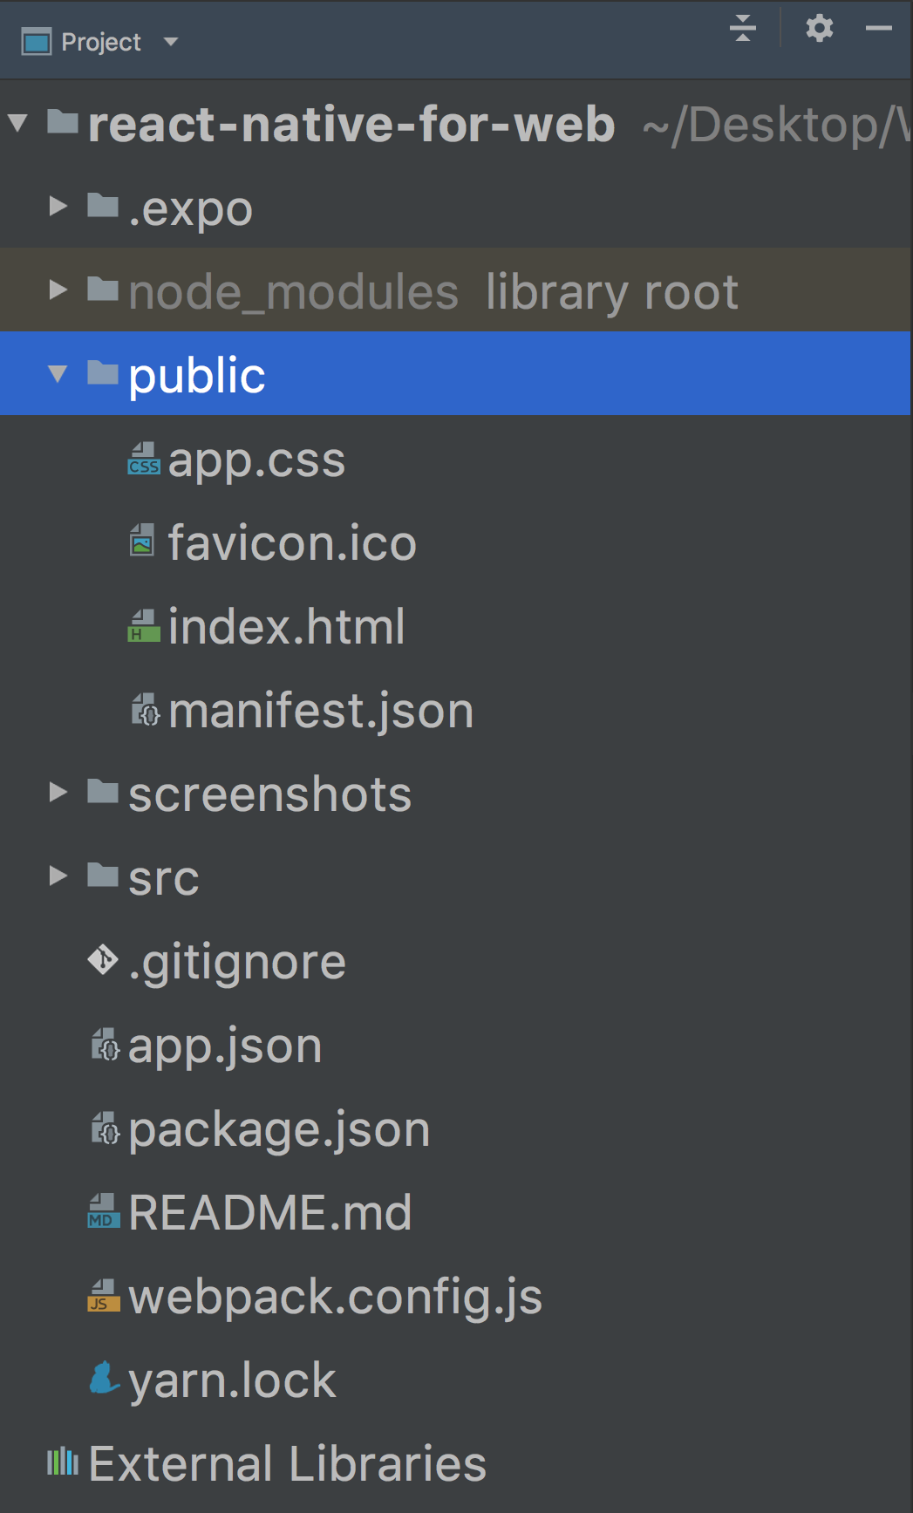
Create React Native App
Notes:
All slides to adopt the above format - Font Type, Font Size, Footer

Slide 35
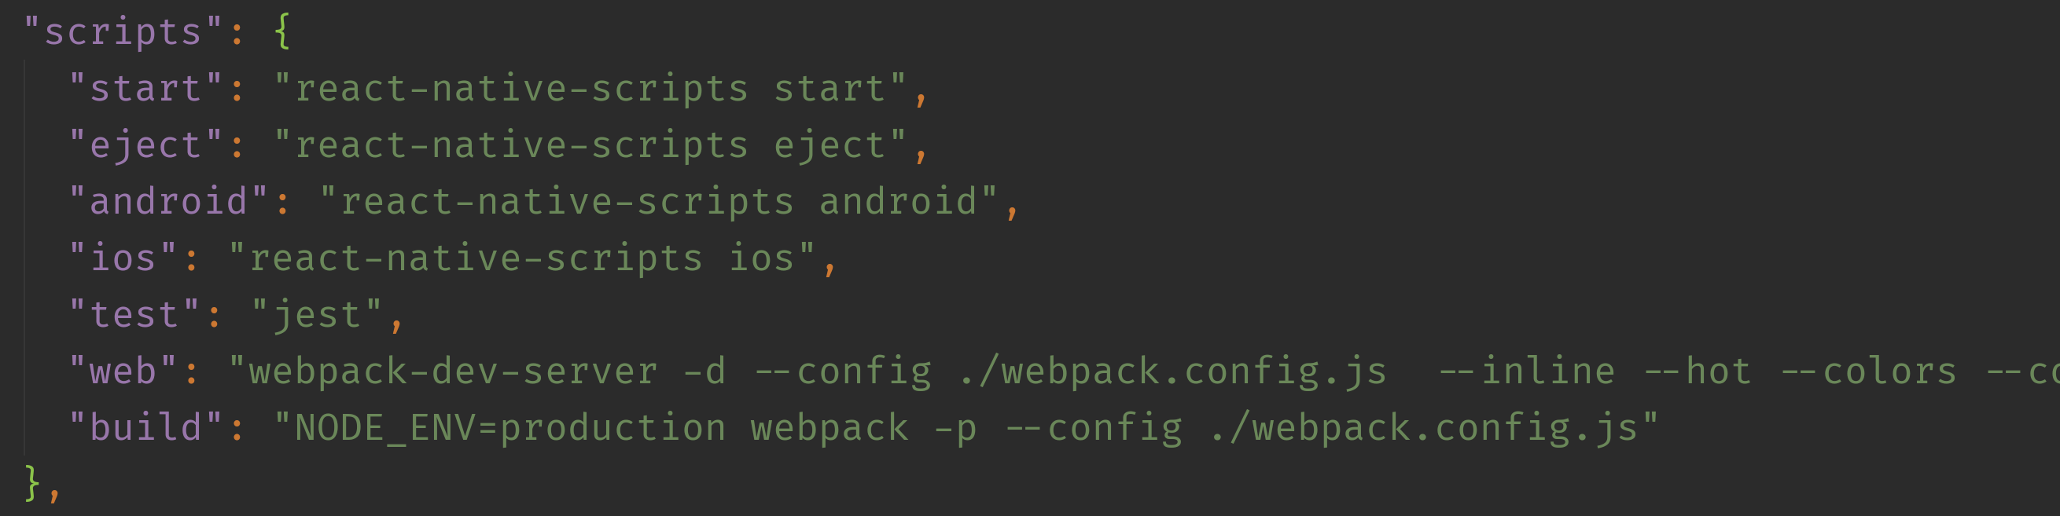
Create React Native App
React Native Scripts
Notes:
All slides to adopt the above format - Font Type, Font Size, Footer

Slide 36
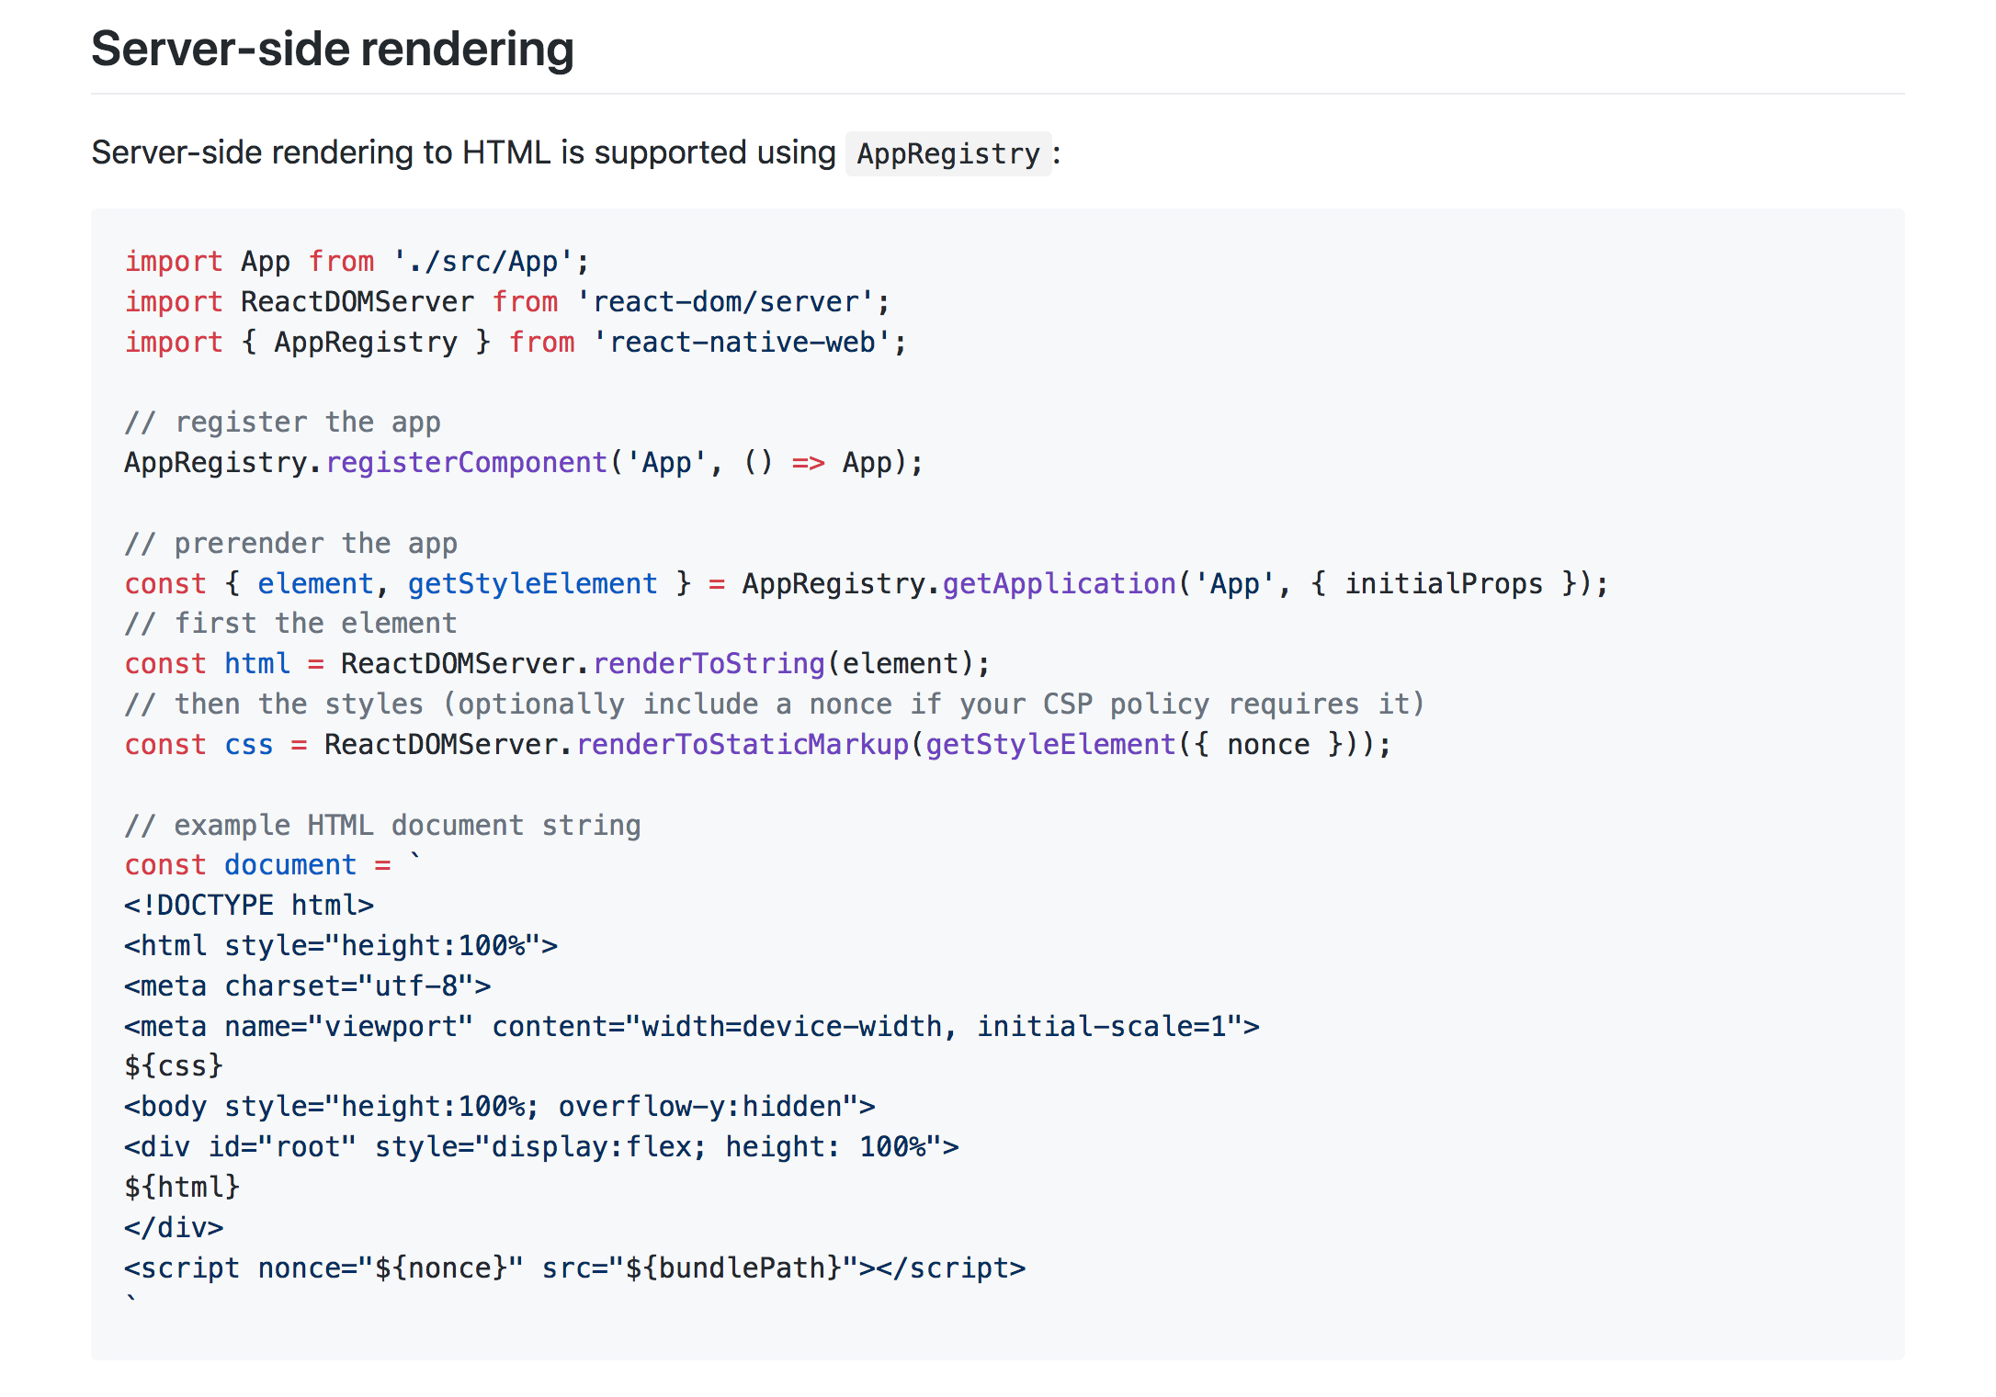

Slide 37
Questions and Answers

Slide 38

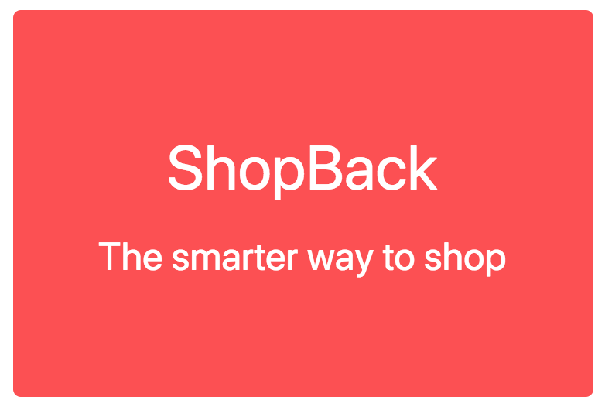
Simple View
ShopBackLogo Component
Notes:
ShopBack in Numbers:
For SG, MY, PH, ID, TH, TW

Slide 39
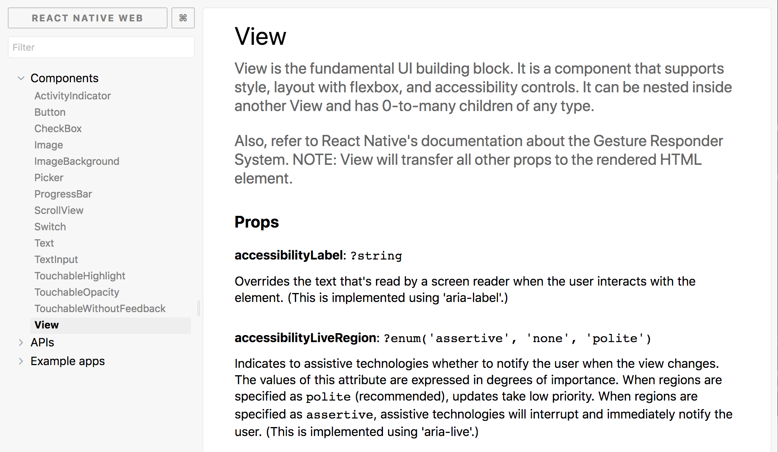
<View /> = <div />
<Text /> = <span />
https://necolas.github.io/react-native-web/storybook/

Slide 40
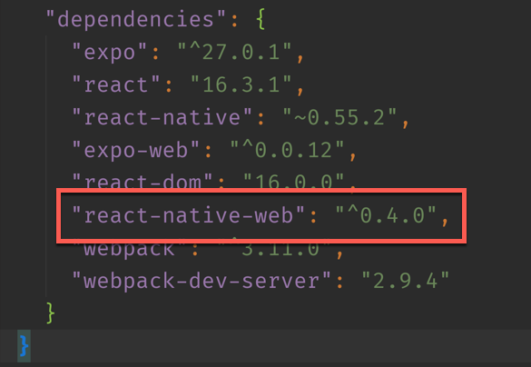
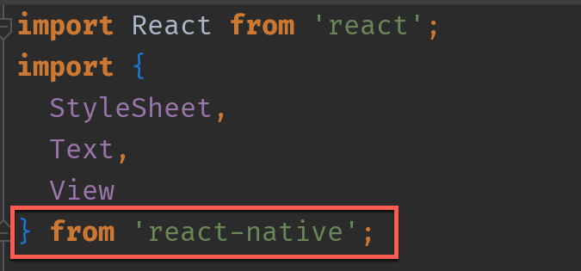
How React Native for Web works ?
Notes:
Detailed ShopBack’s business model: Customer + Merchant journey
For all countries

Slide 41

Element Inspection
Notes:
All slides to adopt the above format - Font Type, Font Size, Footer

Slide 42
Questions and Answers

Slide 43

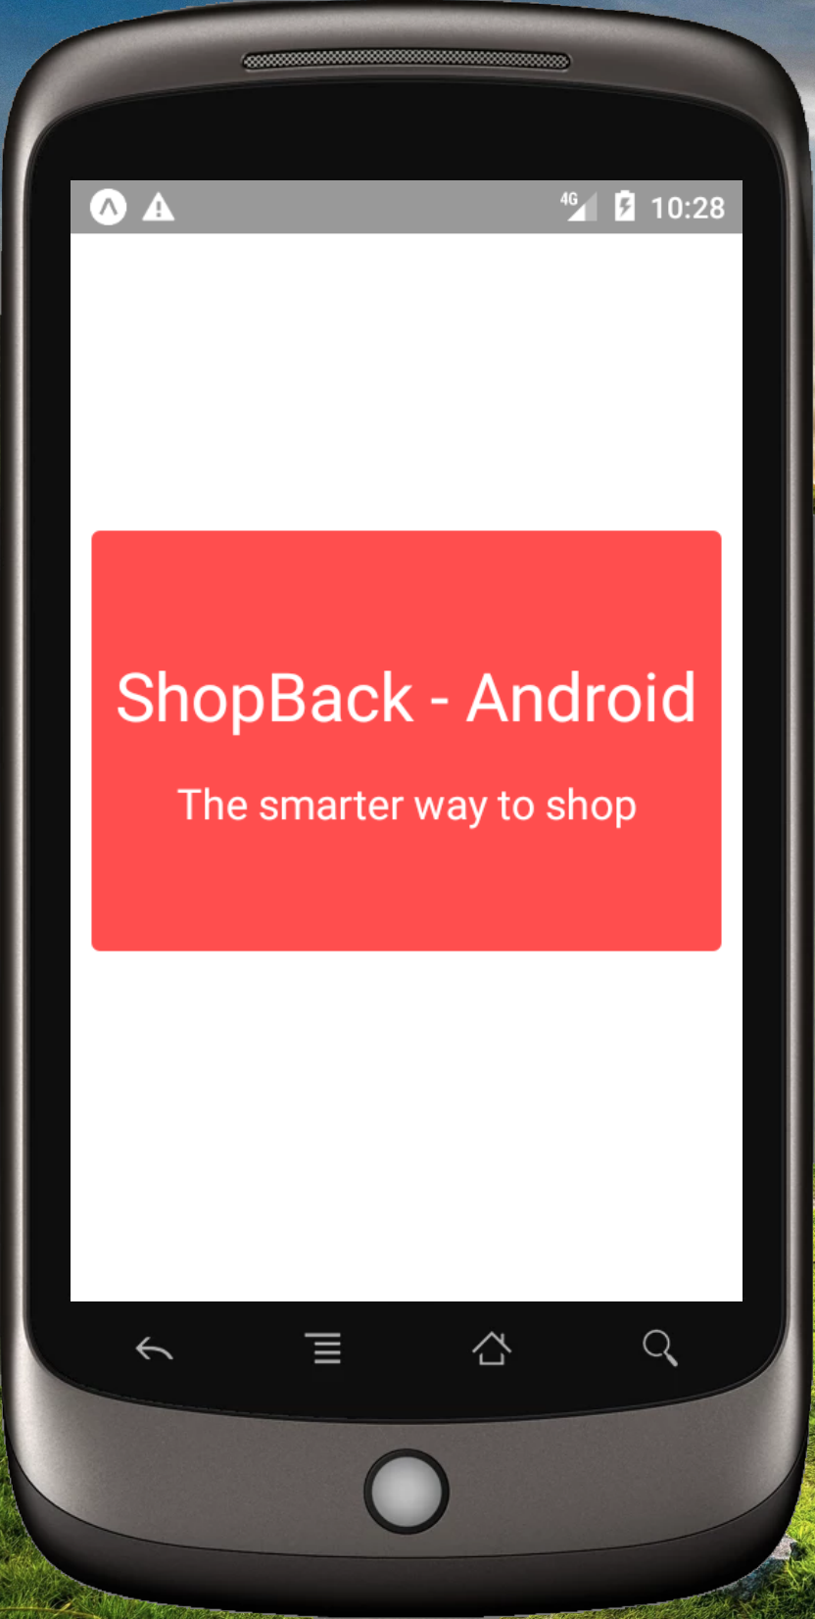
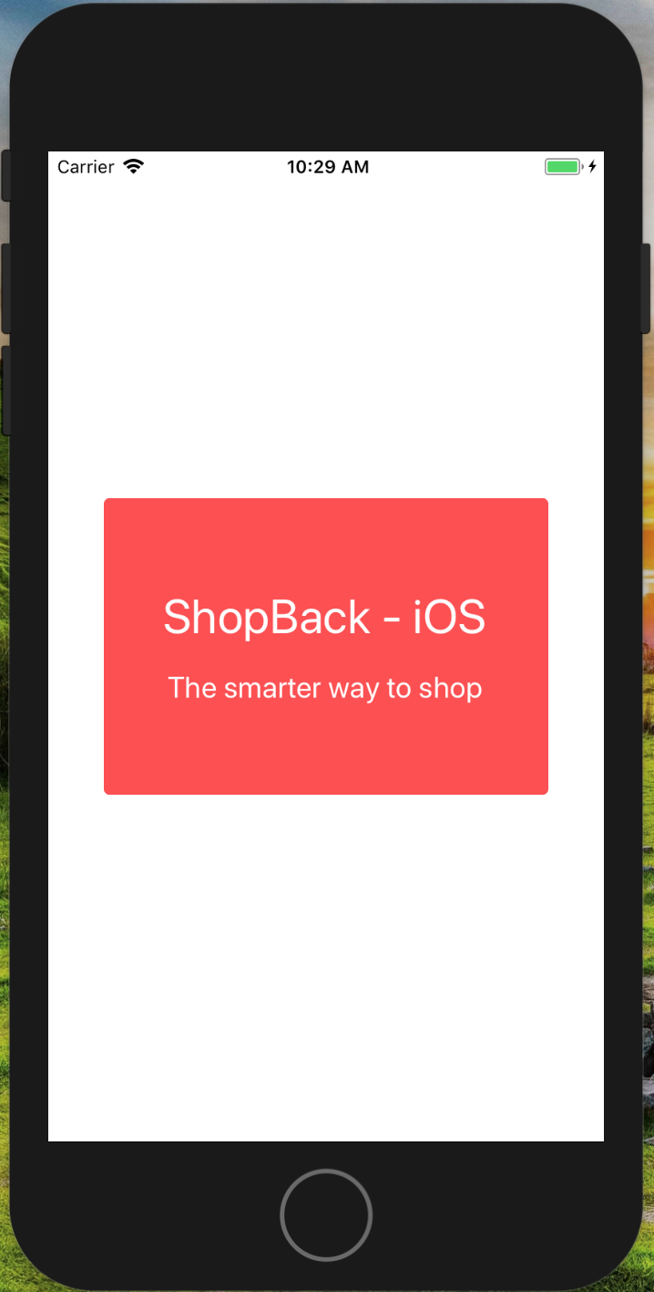
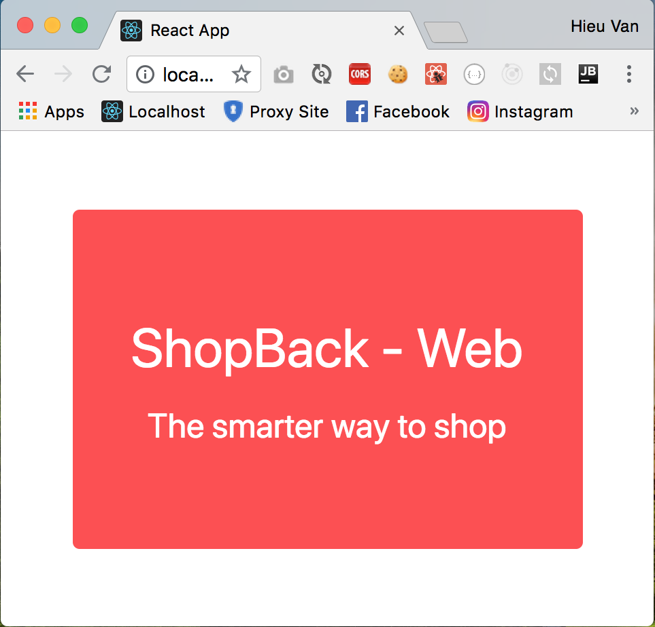
Multi-platform Applications
Android
iOS
Web

Slide 44
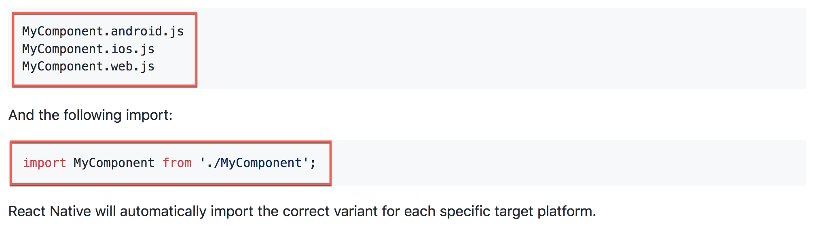
Multi-platform Applications
https://github.com/necolas/react-native-web/blob/master/packages/website/guides/getting-started.md#multi-platform-applications

Slide 45
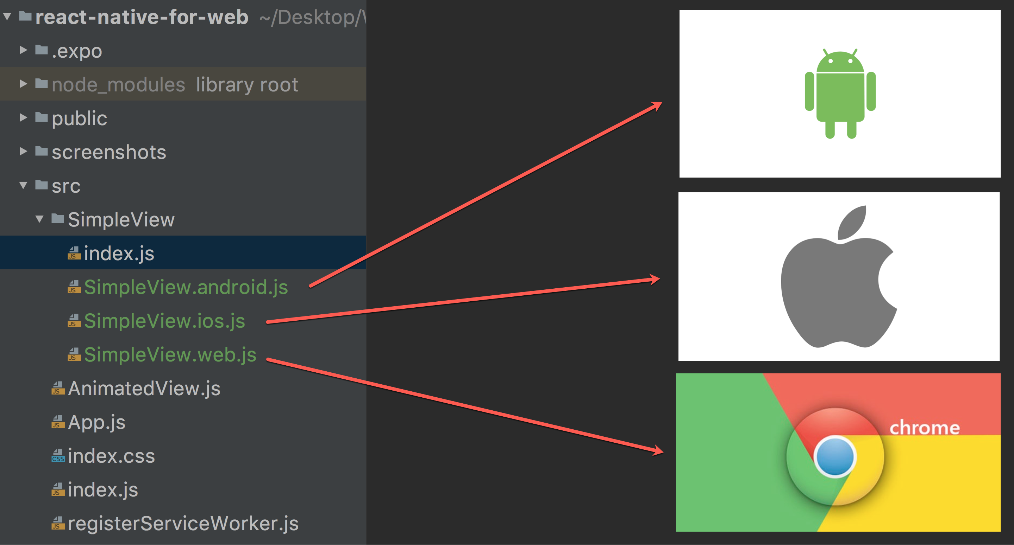

Slide 46
Is there another way to do Web-specific code ?
Notes:
Detailed ShopBack’s business model: Customer + Merchant journey
For all countries

Slide 47
Questions and Answers

Slide 48
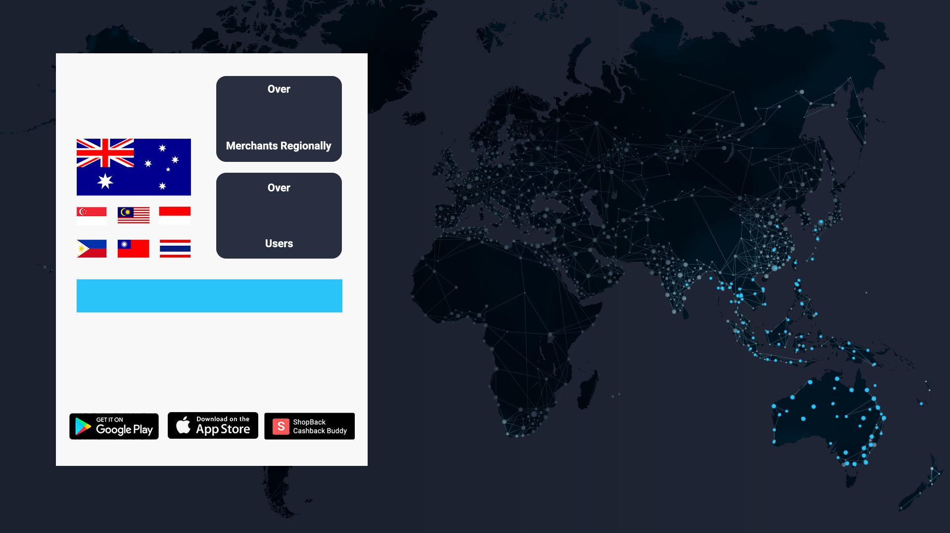
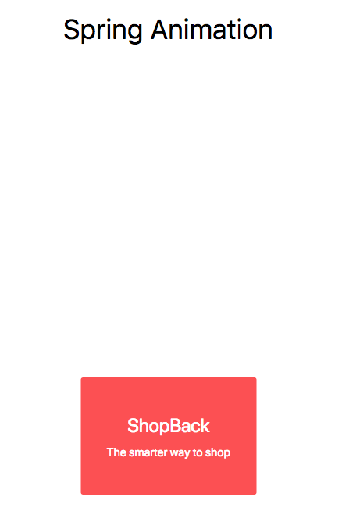

Animated View
Notes:
ShopBack in Numbers:
For AU

Slide 49
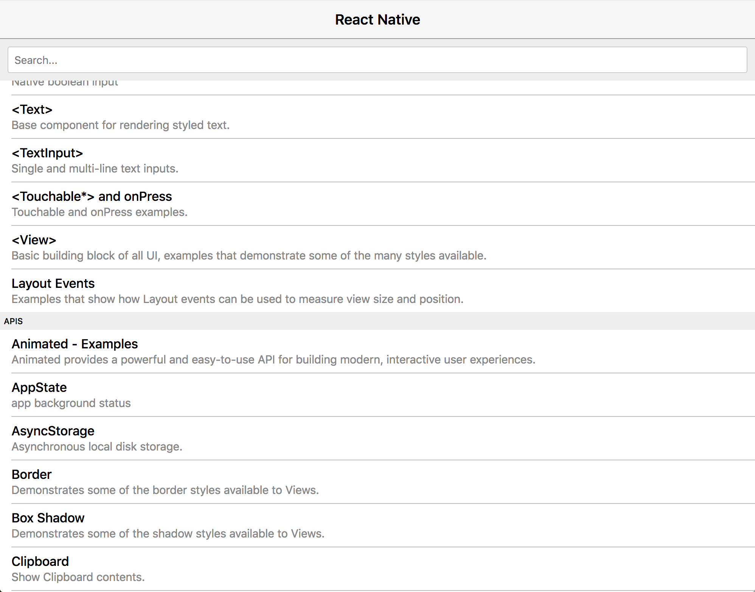
https://necolas.github.io/react-native-web/examples/

Slide 50


Tic Tac Toe
Notes:
Use this slide for “quotable quotes” / points worth highlighting

Slide 51
Questions and Answers

Slide 52


